Slide 1

Smart Seat Allocation & Utilization Management System
MERN-stack based office seat booking platform designed to automate weekly batch allocations, eliminate manual conflicts, and provide actionable utilisation analytics for technical teams.

Slide 2

Problem Statement
Context
Operational Issues
50 seats total (40 fixed, 10 floater). 80 employees in 10 squads (8 per squad). Two rotational batches with alternating weekly schedules.
Manual booking causes seat conflicts, last-minute changes and poor utilisation tracking. No holiday / leave enforcement in bookings.
Impact
Wasted desk capacity, lost developer time resolving conflicts, and no historical analytics to drive space decisions.

Slide 3
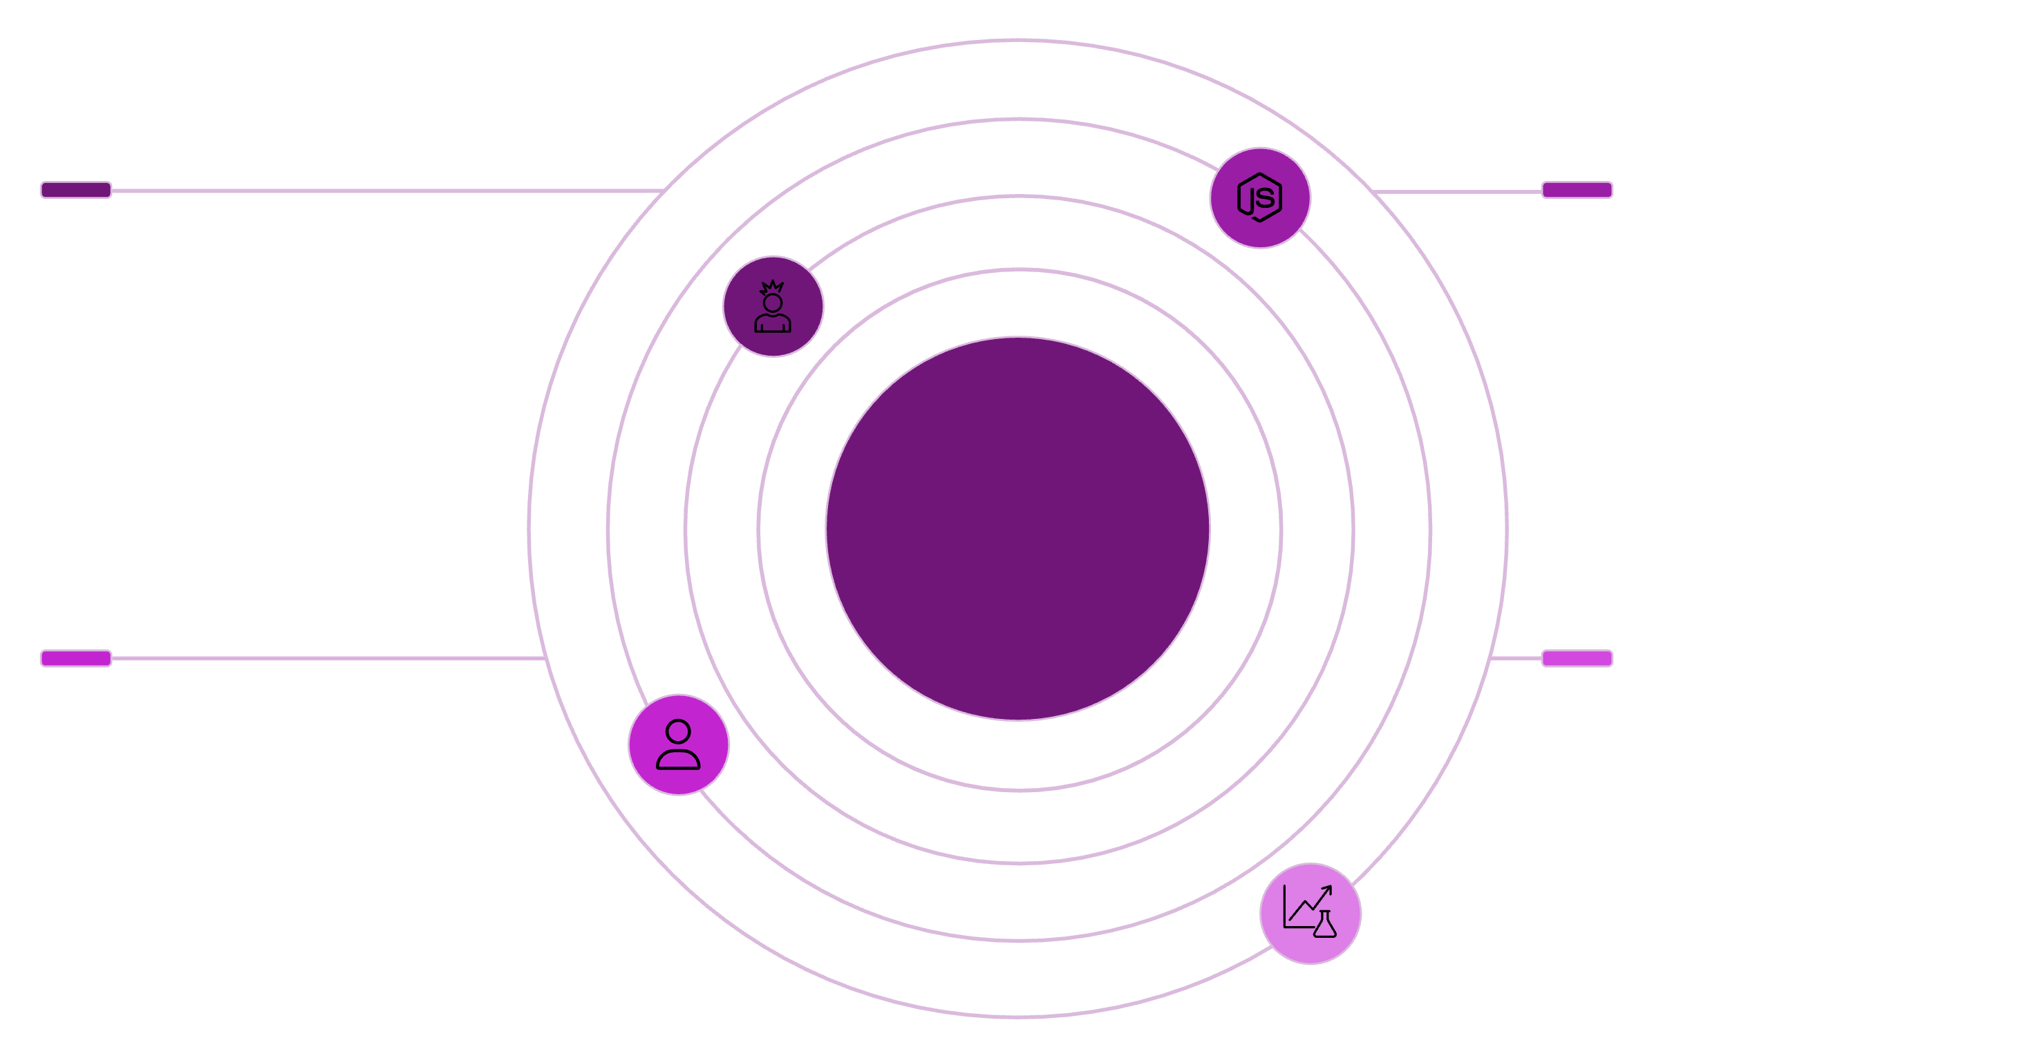




System Architecture (High Level)
React Frontend
Node.js + Express
Calls REST API; optional Socket.io for live updates
Handles API, role auth (admin/worker), and business logic
High-Level System Architecture
MongoDB
Analytics Service
Stores bookings, holidays, and related data
Reads bookings data for reports and insights
Frontend: React.js | Backend: Node.js + Express | Database: MongoDB. REST API for all operations; optional Socket.io for live updates. Services separated for booking, holidays, and analytics.

Slide 4
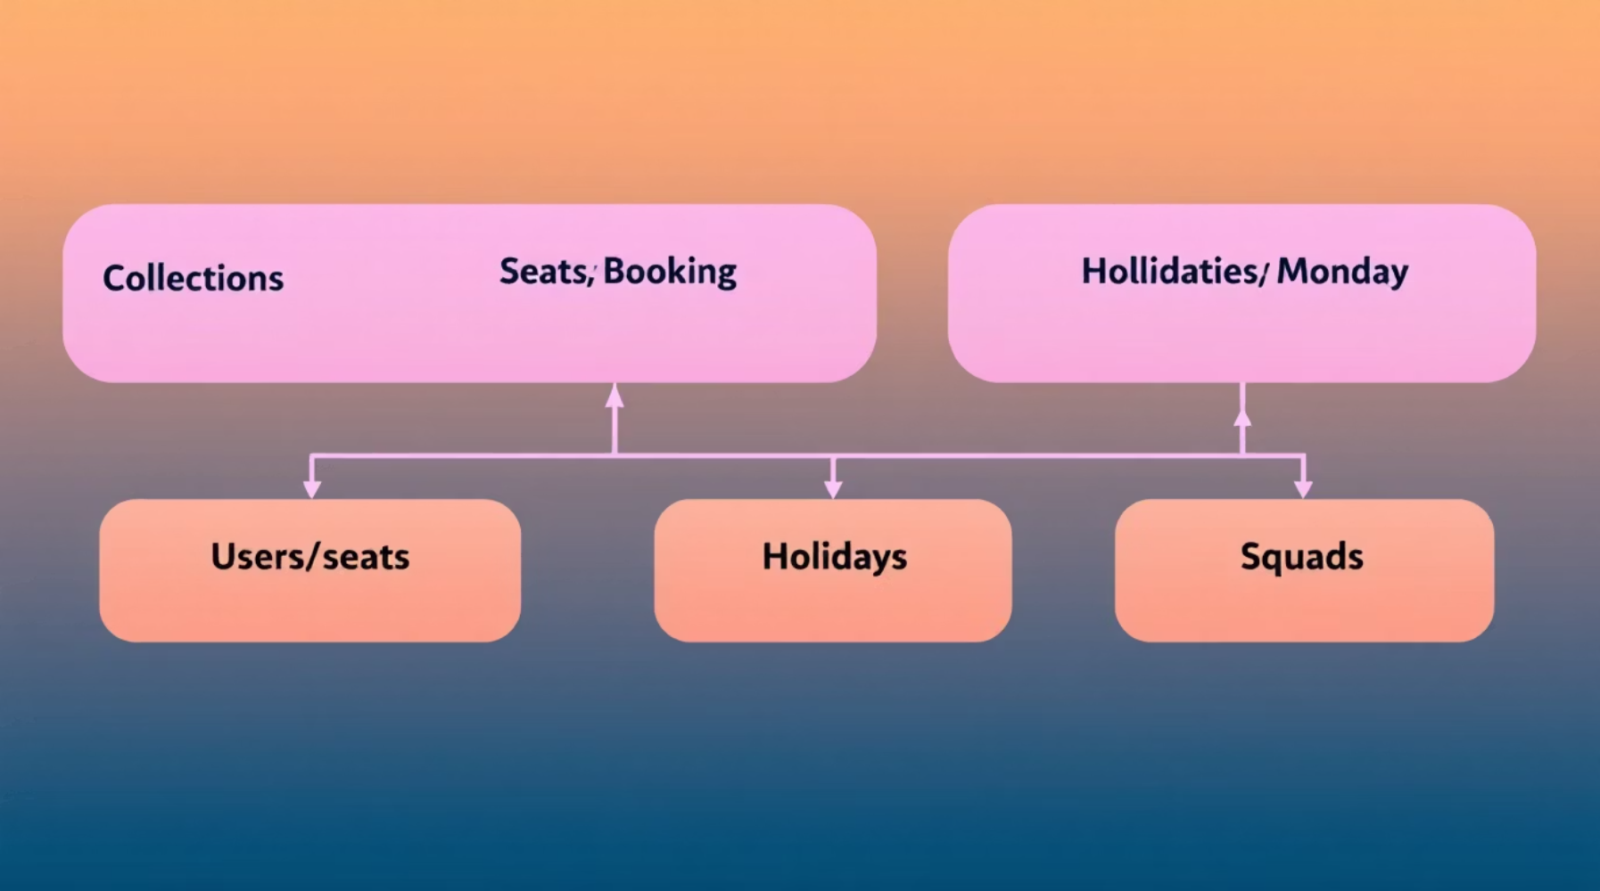





Data Model & Constraints
Database constraint: unique compound index on (seatId, date) in Bookings to prevent duplicate bookings for the same seat/day.
Users
Seats
Bookings
Holidays
Employee profile, squadId, batch assignment, role (user/admin).
seatId, type (fixed/floater), location metadata.
userId, seatId, date, startTime, endTime, status (booked/vacated/blocked).
date, description — enforced as non-bookable days.
Squads
squadId, members, batch assignment.

Slide 5

Batch Logic, Allocation & Core Algorithms
Validate Day
Check Eligibility
Verify Seats
Assign & Confirm
Booking Controls
Allocation Rules
Block new bookings after 15:00 for same-day reservations.
Allow seat vacating (leave) which frees seat and records status.
Reject duplicates using compound unique index and optimistic concurrency checks.
Batch Schedules (summary)
Validate working day (exclude weekends/holidays).
Check user's batch eligibility for the date.
Assign first available seat—prefer fixed squad seats; use floaters if needed.
Batch 1: Week1 Mon–Wed, Week2 Thu–Fri. Batch 2: Week1 Thu–Fri, Week2 Mon–Wed.

Slide 6
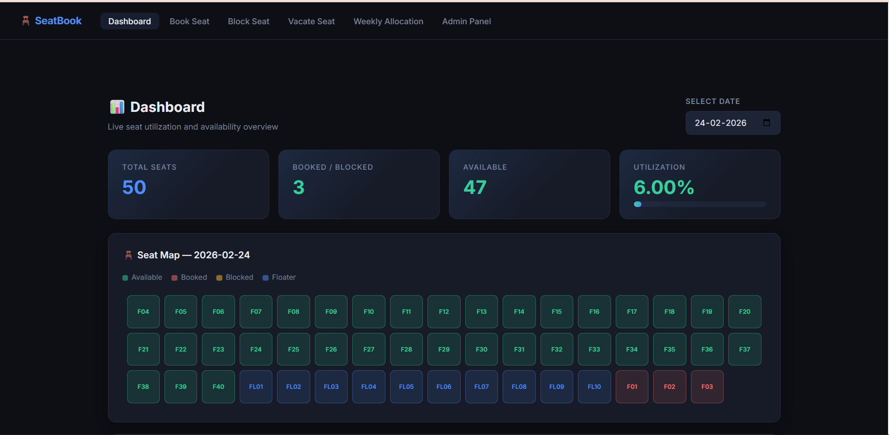
Project Highlights
Fig 1: Dashboard

Slide 7
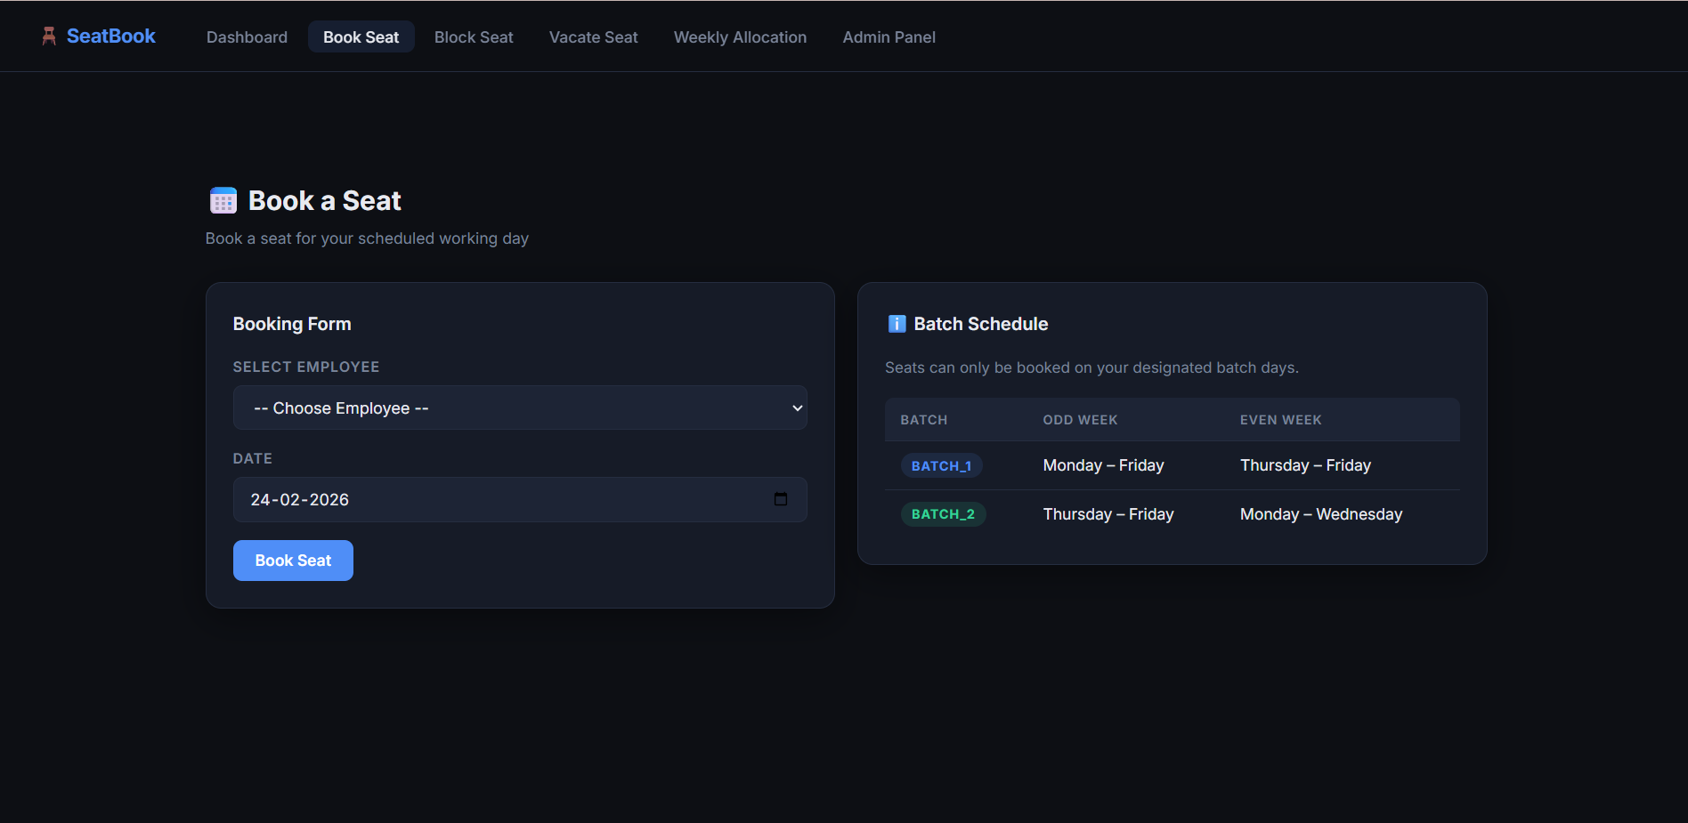
Fig 2: Book a Seat

Slide 8
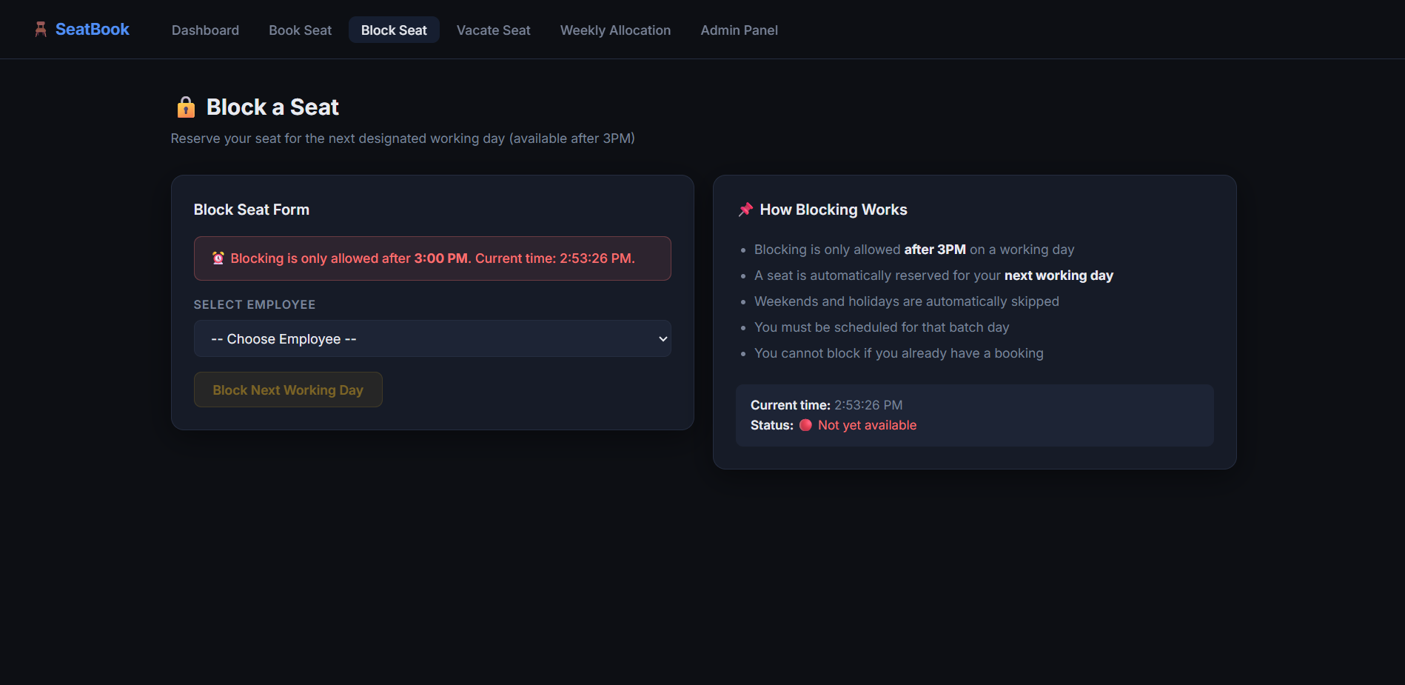
Fig 3: Blocking a seat for the next working day

Slide 9
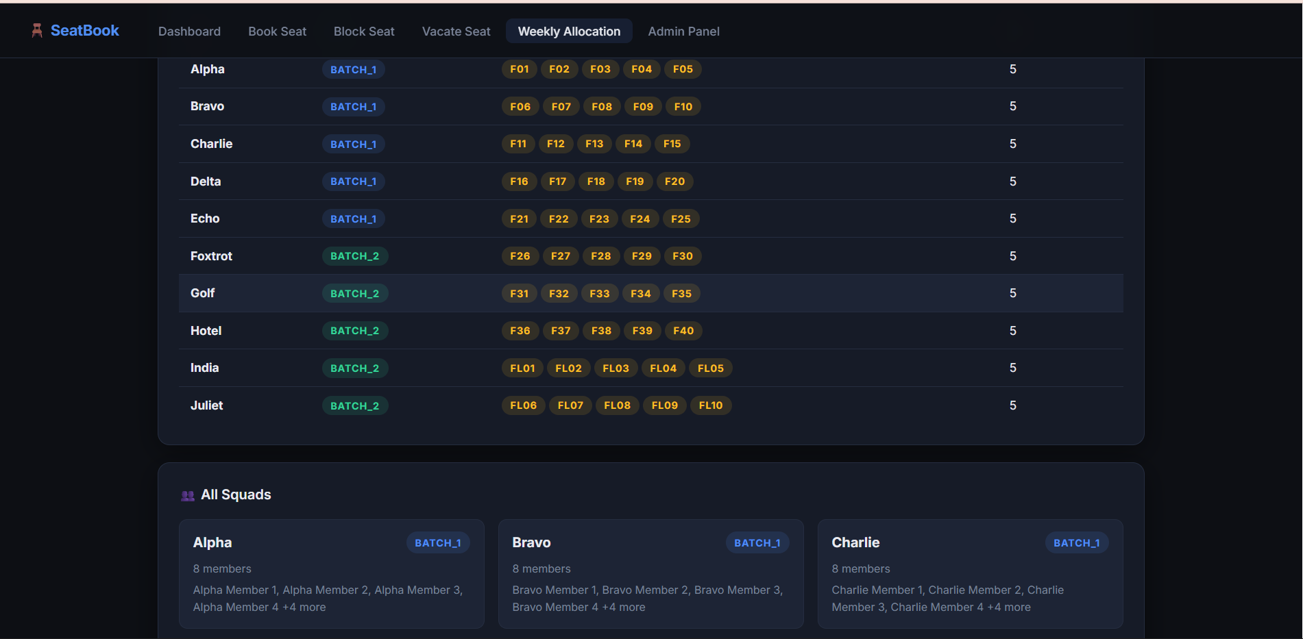
Fig 4: Weekly Allocation

